Slide 1
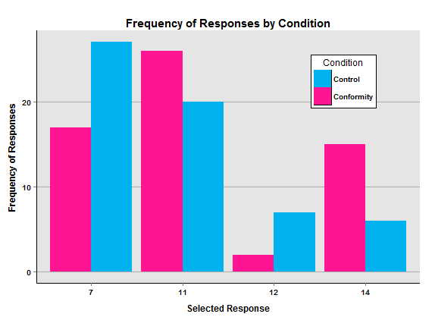
Online Decision Making Using Survey Monkey As an Experimental Platform
Abstract
Reese and Handsaker (2015) proposed that conformity may occur through online contexts. The researchers used Survey Monkey as an online experimental platform. The results indicate participant response choice depends upon condition placement.
Introduction
With the advancement of computers and technology, studies have explored the effect that specific variables may have on the pressure to conform in an online environment. In one study, Zhu and Huberman (2014) aimed to investigate the effect of online recommendations on an individual’s preferred selection.
This study examined how an individual’s personal opinions may be influenced by peer recommendations.
Methods
All Stimuli presented via the online website Survey Monkey.
Participants who selected January, March, May, July, September, or November were put into the control group.
Those whose selected February, April, June, August, October, or December were put into the conformity condition (feedback manipulated).
2³-8÷4×2+7=?.
7 ( 3.3% of participants have selected this answer)
12 (17.8% of participants have selected this answer)
11 (23.7% of participants have selected this answer)
14 (55.2% of participants have selected this answer)
What would you choose?
Results
120 participants were included in this study.
Response choice depends on condition, Chi-Square(3)=9.69, p=.02
Discussion
The purpose of this study is to replicate findings in classic conformity studies (e.g. Asch, 1956) in an online environment. It also was designed to expand upon findings from other studies investigating online conformity (Zhu & Huberman, 2014). This study expands on the work of Zhu and Huberman by offering participants a choice in which there is an objectively correct answer.
Summary
Conformity can still occur online, even when questions have a right and wrong answer. Online education, which often assesses objectively correct knowledge, has become increasingly popular. Thus, a demonstration that peers could adversely affect how often students correctly identify answers or solutions in an online environment could have important pedagogical implications.
References
Zhu, H., & Huberman, B. A. (2014). To switch or not to switch: Understanding social influence in online choices. American Behavioral Scientist, 58, 1329-1344. doi:10.1177/0002764214527089
Asch, S. E. (1956). Studies of independence and conformity: I. A minority of one against a unanimous majority. Psychological Monographs: General and Applied, 70. doi:10.1037/h0093718

